Slide 1
33
International Finance
CHAPTER CHECKLIST
When you have completed your study of this chapter, you will be able to
1 Describe a country’s balance of payments accounts and explain what determines the amount of international borrowing and lending.
2 Explain how the exchange rate is determined and why it fluctuates.
Notes:
Notes and teaching tips: 8, 14, 15, 18, 55, 59, and 67.
To view a full-screen figure during a class, click the red “expand” button.
To return to the previous slide, click the red “shrink” button.
To advance to the next slide, click anywhere on the full screen figure.
To enhance your lecture, check out the Lecture Launchers, Land Mines, and Class Activities in the Instructor’s Manual.

Slide 2
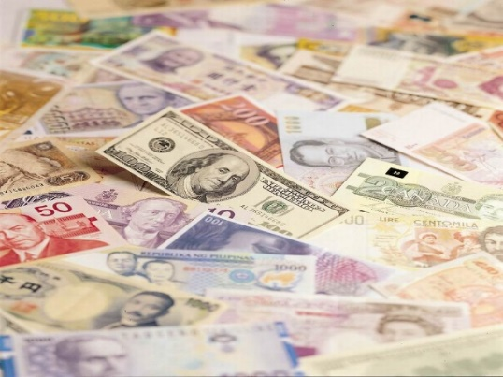
International Trade and Finance
There are only two basic transactions:
People trading good/services for money
People trading assets for money
When people engage in these transactions that are from the same place and use the same currency, it’s not an issue. But when they’re from different place and use different currencies, buyers have to convert their currencies into one that the seller accepts.

Slide 3
33.1 FINANCING INTERNATIONAL TRADE
Balance of Payment Accounts
A country’s balance of payments accounts records its all international trading, borrowing, and lending that takes place between its residents and the residents of other nations.
Transactions fall into two main categories – trade and asset transactions.
International trade involves the buying and selling of good or services across international borders.
Egypt exports cotton to the US; US company hires a call center in England to answer its phone calls.
International asset transactions involve the transfer of the property rights to either real or financial assets between citizens of different nations.
Buying and selling foreign stocks; selling your house in California to a Swedish citizen.

Slide 4
International Trade and Finance
Every nation keeps a balance of payment statement (account) and categorizes their statement into two main elements:
Current Account
Capital/Financial Account

Slide 5
Clifford – Balance of Payment

Slide 6
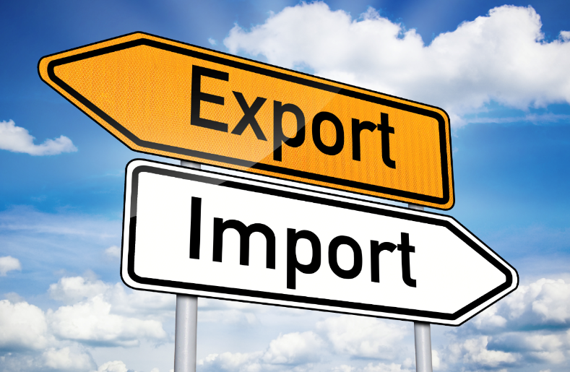
Balance of Payment
Current account – summarizes and records all goods and services to other countries (exports), minus payments for goods and services bought from other countries (imports), plus the net amount of interest and transfers received from and paid to other countries. [Exports and Imports are the largest components]
Capital account/Financial account records foreign investment in the United States minus U.S. investment abroad.

Slide 7
Balance of Payments
A list of all the payments a nation receives from foreign countries and all the payments it makes to other nations.
Debit = negative entry on balance sheet
Credit = positive entry on balance sheet
Current Account includes:
Balance on Goods (export goods – import goods)
Balance on Services (export services – import services)
If exports are greater = surplus; less = deficit
Xn (net exports = Exports - Imports), net investment income (interest & dividends) and net transfer payments (public and private)
“Current”, short-term, day to day transactions of goods and services
Xn includes tourism
Exports = credits (+); imports = debits (-)

Slide 8
What does the statement tell us?

Slide 9
Capital or Financial Account Includes
Payments for financial assets (savings, CDs, bonds and stocks) and real assets (buildings, land, plant/factory, etc.)
If it involves taking ownership of a real asset, i.e. buildings, land, stocks, bonds it falls under capital account. The asset is “staying” in that country.
Important Note – payments from interest earned on real assets such as stocks, bonds, and savings accounts are included in current account. The actual purchase of these assets is in the capital account.
Also includes “noncurrent” items of a more permanent or long term nature
*** Important Point – A capital good like a robot is still Current Account not Capital/Financial account

Slide 10
Balance of Payments Examples
Purchase of a U.S. bond by China
Capital or Financial Account
U.S. interest payments on the bond
Current Account
Savings account held by Japan
Capital Account
Interest paid on savings
Current Account

Slide 11
What do you think?
American Company buys refrigerators from a British Company
Current Account – This is a finished product and therefore not a real asset.
American Company buys a Japanese computer assembly plant
Capital Account because they are buying ownership of a company which is a real asset.

Slide 12
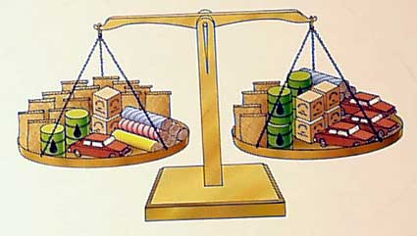
Capital or Current Account
American Citizen buys a hotel in Germany
Capital Account because they are buying ownership
American citizen buys a German Government Bond
Capital Account
Interest payment on the bond
Current Account

Slide 13
Test Your Knowledge, Boo!
Balance of payments accounts record all of a country’s international transactions during a year.
(a) Two major subaccounts in the balance of payments accounts are the current account and the capital account. In which of these subaccounts will each of the following transactions be recorded?
(i) A United States resident buys oranges from Brazil.
(ii) A United States manufacturer buys automated car manufacturing equipment from Germany.
(b) How would an increase in the real income in the United States affect the United States current account balance? Explain.

Slide 14
What you thinkin’ son?
Suppose that Belgium increases its tariff rates on all of its imports of automobiles from abroad.
(a) How would the increase in the tariff rates affect each of the following in Belgium?
(i) Current account balance. Explain.
(ii) Capital account balance
(c) Given the change in Belgium’s current account in part (b)(i), what will happen to the aggregate demand in Belgium? Explain.

Slide 15
33.2 THE EXCHANGE RATE
Foreign exchange market is the market in which the currency of one country is exchanged for the currency of another. This is often referred to as “FOREX”.
The foreign exchange market is made up of importers and exporters, banks, and specialist dealers who buy and sell currencies.
Foreign exchange rate is the price at which one currency exchanges for another.
**A lot of silly ideas about the exchange rate find their way into the popular media. The most notable one is that the strength of a nation’s currency on the foreign exchange market is somehow a sign of the nation’s overall strength. The exchange rate is just a price. And it is the relative price of two currencies that ultimately depends on the price levels in two countries. A downward trend in an exchange rate means that a country is experiencing more rapid inflation that another country. That is all. The exchange rate trend tells us nothing—absolutely nothing—about productivity and real income growth in the two countries.
Notes:
A lot of silly ideas about the exchange rate find their way into the popular media. The most notable one is that the strength of a nation’s currency on the foreign exchange market is somehow a sign of the nation’s overall strength. Explain that the exchange rate is just a price. And it is the relative price of two currencies that ultimately depends on the price levels in two countries. A downward trend in an exchange rate means that a country is experiencing more rapid inflation that another country. That is all. The exchange rate trend tells us nothing—absolutely nothing—about productivity and real income growth in the two countries.

Slide 16
THE EXCHANGE RATE
Currency appreciation is the rise in the value of one currency in terms of another currency.
For example, when the dollar rose from 86 euro cents in 1999 to 1.17 euros in 2001, the dollar appreciated by 36 percent.
Currency depreciation is the fall in the value of one currency in terms of another currency.
For example, when the dollar fell from 1.17 euros in 2001 to 0.68 euros in 2009, the dollar depreciated by 42 percent.

Slide 17
33.2 THE EXCHANGE RATE
The Law of Demand for Foreign Exchange
Other things remaining the same, the higher the exchange rate, the smaller is the quantity of dollars demanded. Adverse relationship between exchange rate and Qd of dollars.

Slide 18
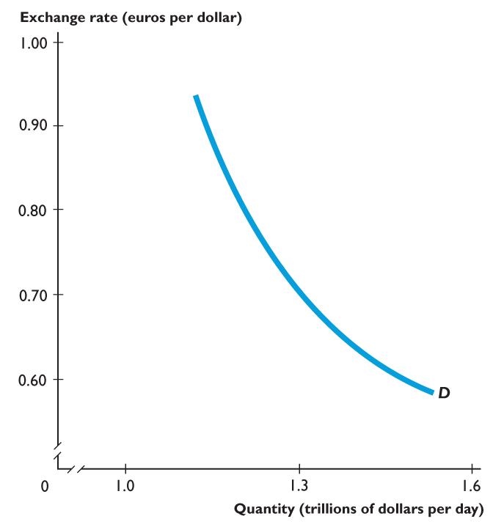
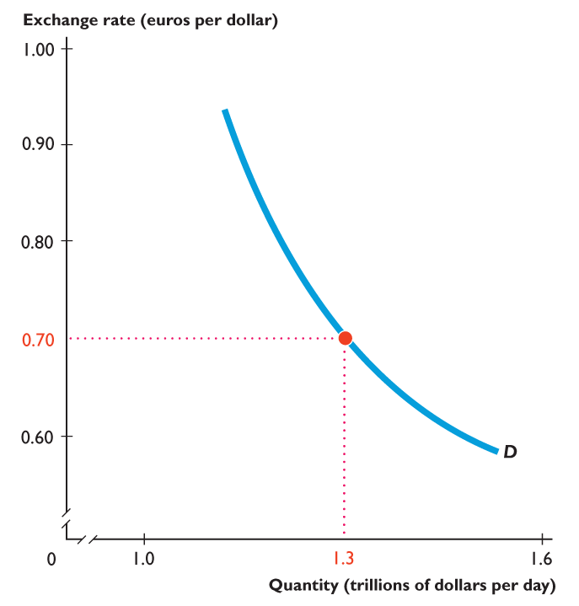
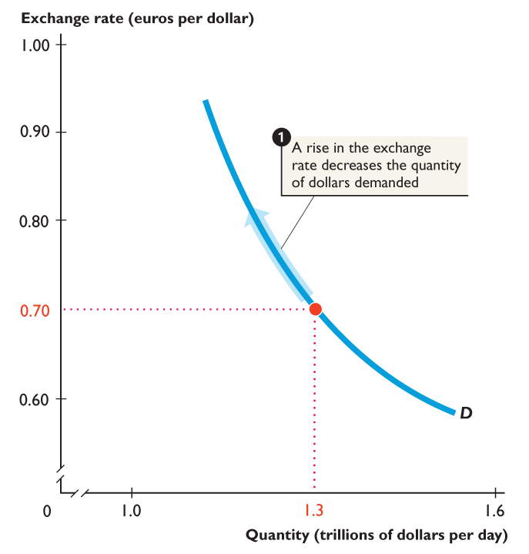
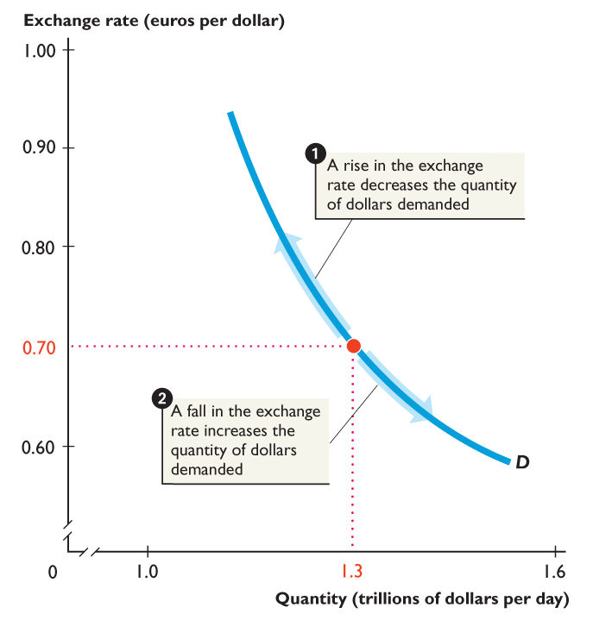
33.2 THE EXCHANGE RATE
Figure 33.1 shows the demand for dollars.
1. If the exchange rate rises, the quantity of dollars demanded decreases along the demand curve for dollars.
2. If the exchange rate falls, the quantity of dollars demanded increases along the demand curve for dollars.

Slide 19
Exports Effect
The larger the value of U.S. exports, the larger is the quantity of dollars demanded on the foreign exchange market.
The lower the exchange rate, the cheaper are U.S.-made goods and services to people in the rest of the world, the more the United States exports, and the greater is the quantity of U.S. dollars demanded to pay for them.

Slide 20
Determinants of Exchange Rates – Causes a Shift
Change in Tastes
Change in relative incomes – recession or consumer wealth
Change in relative prices – inflation
Change in relative real interest rates
Speculation

Slide 21
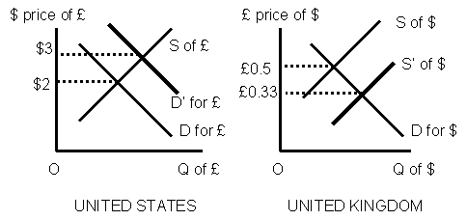
Hint
Any time one currency’s demand shifts, the other currency’s supply graph shifts IN THE SAME DIRECTION.

Slide 22
The Lands of Blue and Pink Money - Exchange Rate Example
Citizens in Blue Land love the chocolate from Pink Land.
What happens in the Foreign Exchange Market (Forex)?
Blue Land citizens demand Pink Land’s Pink dollars so they can buy Pink’s chocolate. **Forex Market--Increase in demand
What happened to the supply of Blue Dollars in the Forex Market? Increase in supply

Slide 23
33.2 THE EXCHANGE RATE
Interest Rates in the United States and Other Countries
U.S. interest rate differential is the U.S. interest rate minus the foreign interest rate.
Other things remaining the same, the larger the U.S. interest rate differential, the greater is the demand for U.S. assets and the greater is the demand for dollars on the foreign exchange market.
In other words- If the price of US dollars (the interest rate) is higher than a foreign currency, people will want to hold more US dollars

Slide 24
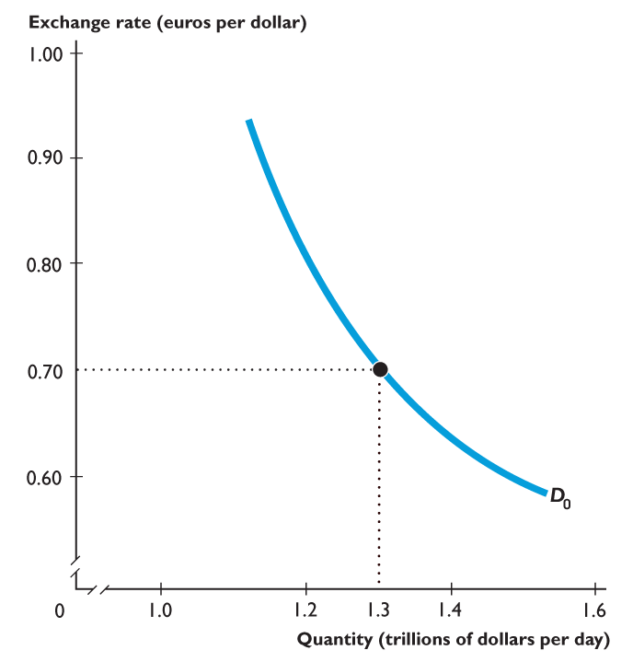
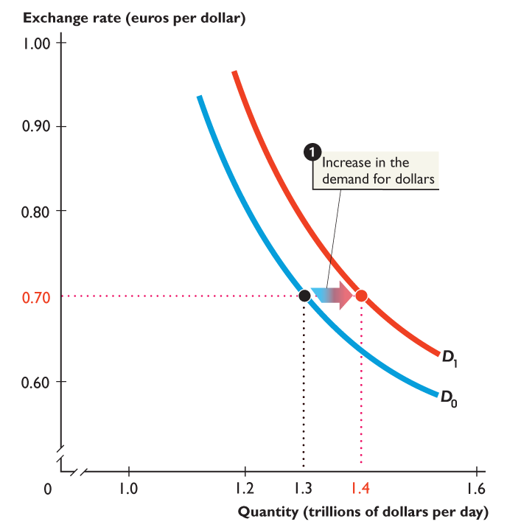
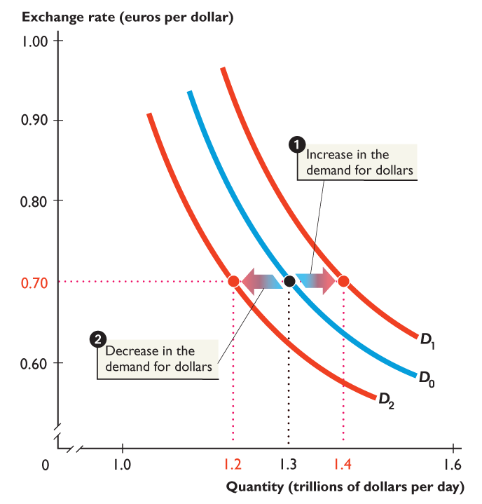
33.2 THE EXCHANGE RATE
Figure 33.2 shows changes in the demand for dollars.
1. An increase in the demand for dollars.
2. A decrease in the demand for dollars.

Slide 25
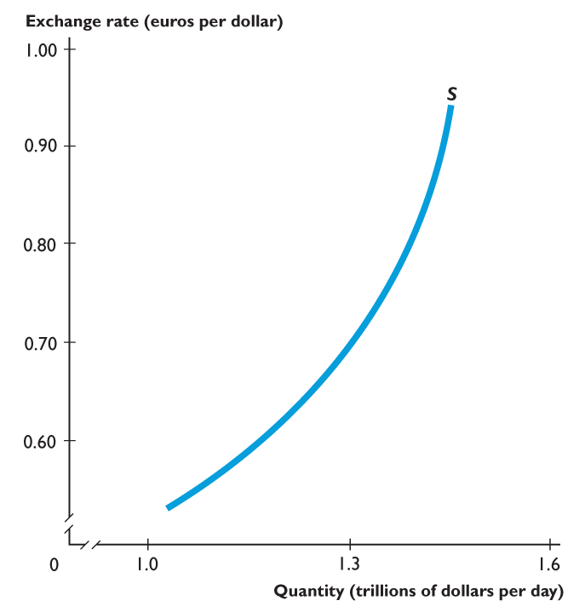
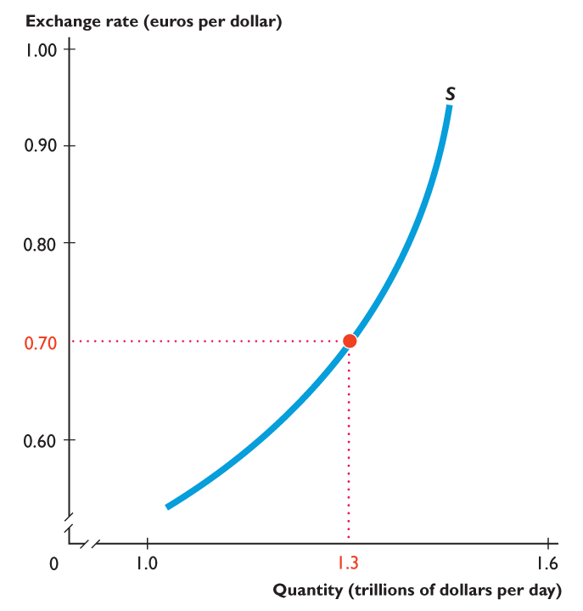
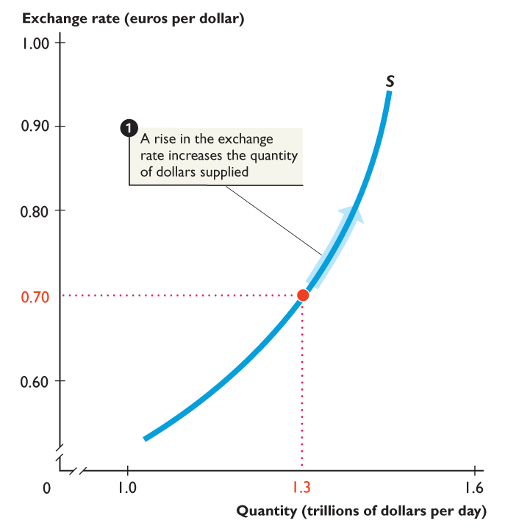
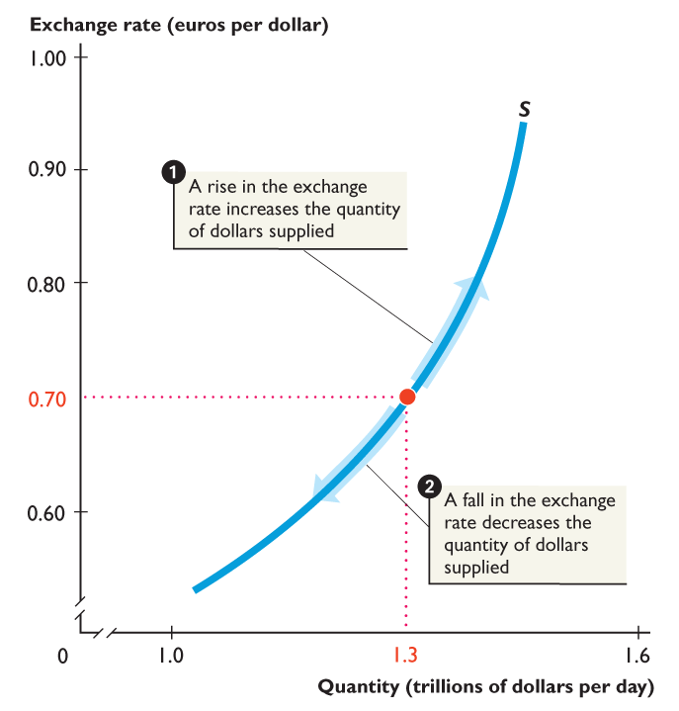
33.2 THE EXCHANGE RATE
Figure 33.3 shows the supply of dollars.
1. If the exchange rate rises, the quantity of dollars supplied increases along the supply curve for dollars.
2. If the exchange rate falls, the quantity of dollars supplied decreases along the supply curve for dollars.

Slide 26
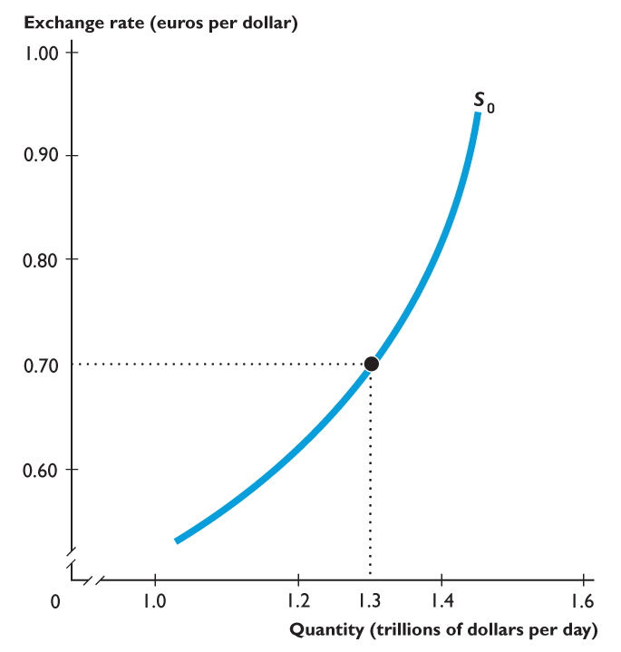
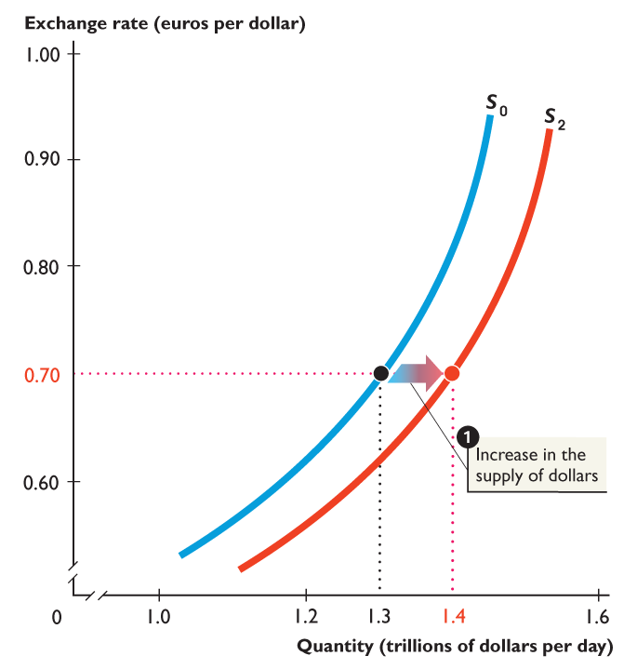
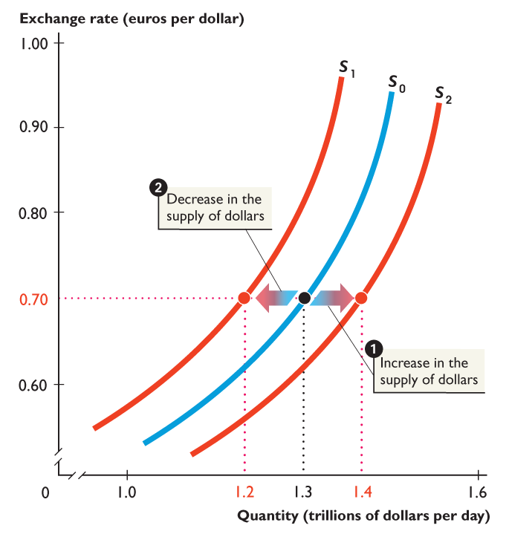
33.2 THE EXCHANGE RATE
Figure 33.4 shows changes in the supply of dollars.
1. An increase in the supply of dollars.
2. A decrease in the supply of dollars.

Slide 27
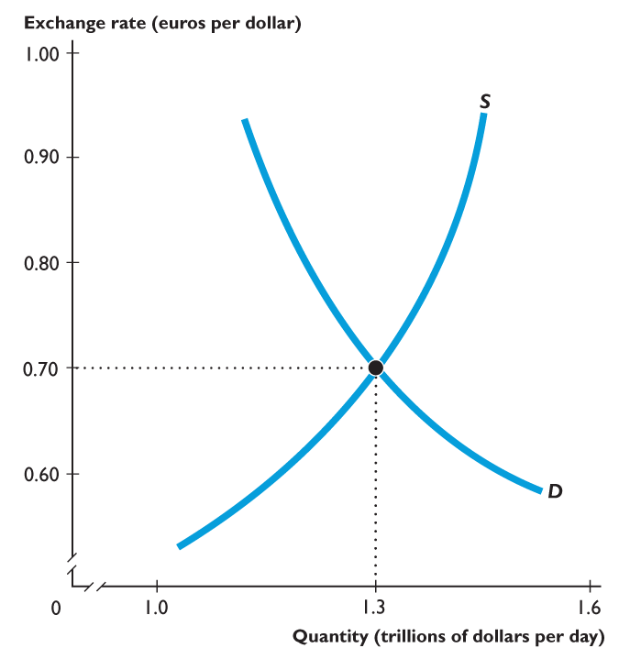
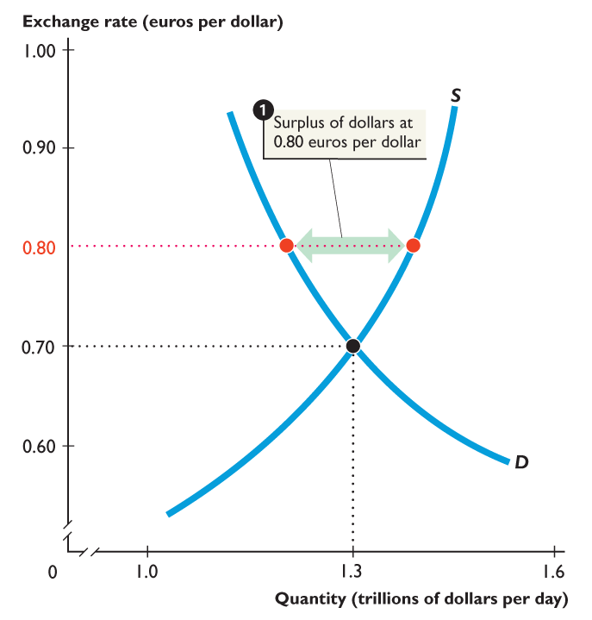
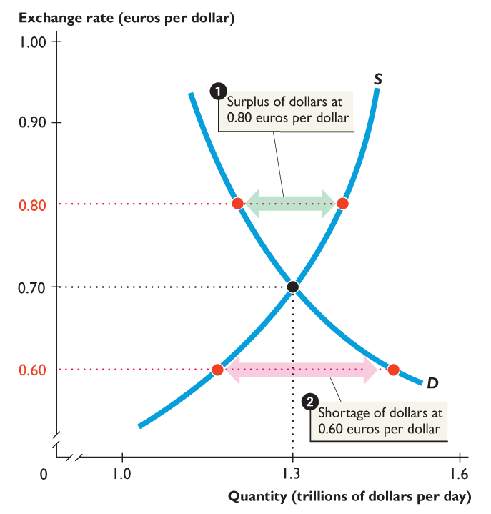
33.2 THE EXCHANGE RATE
Figure 33.5 shows the equilibrium exchange rate.
1. If the exchange rate is 0.80 euros per dollar, there is a surplus of dollars and the exchange rate falls.
2. If the exchange rate is 0.60 euros per dollar, there is a shortage of dollars and the exchange rate rises.

Slide 28
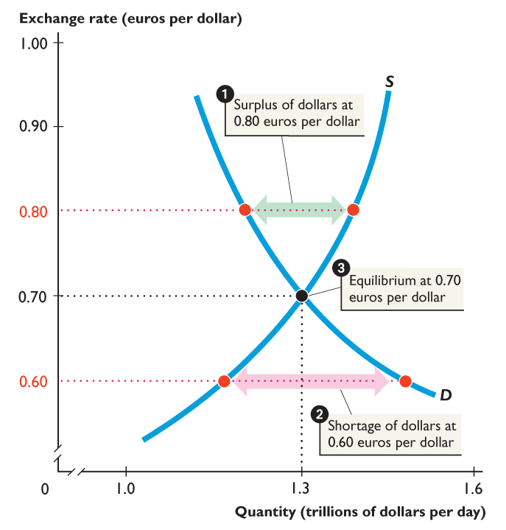
33.2 THE EXCHANGE RATE
3. If the exchange rate is 0.70 euros per dollar, there is neither a shortage nor a surplus of dollars and the exchange rate remains constant. The market is in equilibrium.

Slide 29
33.2 THE EXCHANGE RATE
Exchange Rate Expectations
Exchange rate expectations change for 2 reasons:
Purchasing power parity theory means equal value of money—a situation in which money buys the same amount of goods and services in different currencies.
Interest Rate parity works the same way, the interest rate is the price of the currency, all prices are going to be equal regardless of exchange rate in the long run.
Notes:
Use the Big Mac PPP to explain further the forces of purchasing power parity and deviations from purchasing power parity (PPP). Each year, The Economist calculates a Big Mac PPP exchange rate for a number of developed and developing economies. The Economist uses this to show which currencies are “overvalued” and which are “undervalued.” You can also use this, however, to show deviations from PPP in Big Mac prices. You may want to hand out the table or use it as an overhead in class to show the different prices of Big Macs across the globe. This can be a useful way to get the students to explain PPP before giving a formal economic definition. Describe how an individual can arbitrage away the Big Mac price difference by trading a Big Mac across countries (by buying a Big Mac in a low-price country and selling it in a high-price country). Students will immediately see that the Big Mac is not a tradable good…at least, it is likely none of them will want to eat a Big Mac that has spent hours if not days in transit! Now ask them to think about the components of the Big Mac. Will PPP hold for the tradable components such as onions, beef, buns, and pickles that make up the Big Mac? What about the other non-tradable components such as the labor and the rent on the building? This exercise can help to solidify the basic idea of PPP while allowing students to see why PPP will not hold at all times.

Slide 30
The Big Mac Index

Slide 31
33.2 THE EXCHANGE RATE
Suppose that a Big Mac costs $4 (Canadian) in Toronto and $3 (U.S.) in New York.
If the exchange rate is $1.33 Canadian per U.S. dollar, then the two monies have the same value—you can buy a Big Mac in Toronto or New York for either $4 Canadian or $3 U.S.
But if a Big Mac in New York rises to $4 and the exchange rate remains at $1.33 Canadian per U.S. dollar, then money buys more in Canada than in the United States.
Money does not have equal value. What will happen? Demand for Canadian $ rises

Slide 32
33.2 THE EXCHANGE RATE
The value of money is determined by the price level.
If prices in the United States rise faster than those of other countries, people will generally expect the foreign exchange value of the U.S. dollar to fall.
Demand for U.S. dollars will decrease, and supply of U.S. dollars will increase.
The U.S. dollar exchange rate will fall.
The U.S. dollar depreciates.

Slide 33
33.2 THE EXCHANGE RATE
If prices in the United States rise more slowly than those of other countries, people will generally expect the foreign exchange value of the U.S. dollar to rise.
Demand for U.S. dollars will increase, and supply of U.S. dollars will decrease.
The U.S. dollar exchange rate will rise.
The U.S. dollar appreciates.

Slide 34
Draw the graph….Do you shift S or D? Does the peso or the dollar—appreciate/depreciate??
The U.S. reduces tariffs on Mexican products.
Americans will want to purchase the less expensive Mexican products.
Demand for peso will increase
Supply of $$ will increase

Slide 35
Draw the graph….Do you shift S or D? Does the peso or the dollar—appreciate/depreciate??
2. Mexico encounters severe inflation.
Higher prices in Mexico.
Americans will not purchase Mexican products.
Demand for the peso will decrease or
Supply for the peso will increase

Slide 36
What happens to the Euro? Draw a graph for Euro and U.S. Dollar then explain #38-6 MB
1. U.S. reduces tariffs on Euro products
Appreciates
2. Europe encounters severe inflation
Depreciate
3. Decrease in American tourism to Europe.
Depreciate
4. U.S. engages in a high interest rate monetary policy
Depreciate

Slide 37
5. European products become more fashionable to U.S. consumers.
Appreciate
6. U.S. firms invest in European oil fields.
Appreciate

